Slide 1
FOAM X2 500g
40 Grit

Slide 2

Sandpaper

Slide 3

0

Slide 4
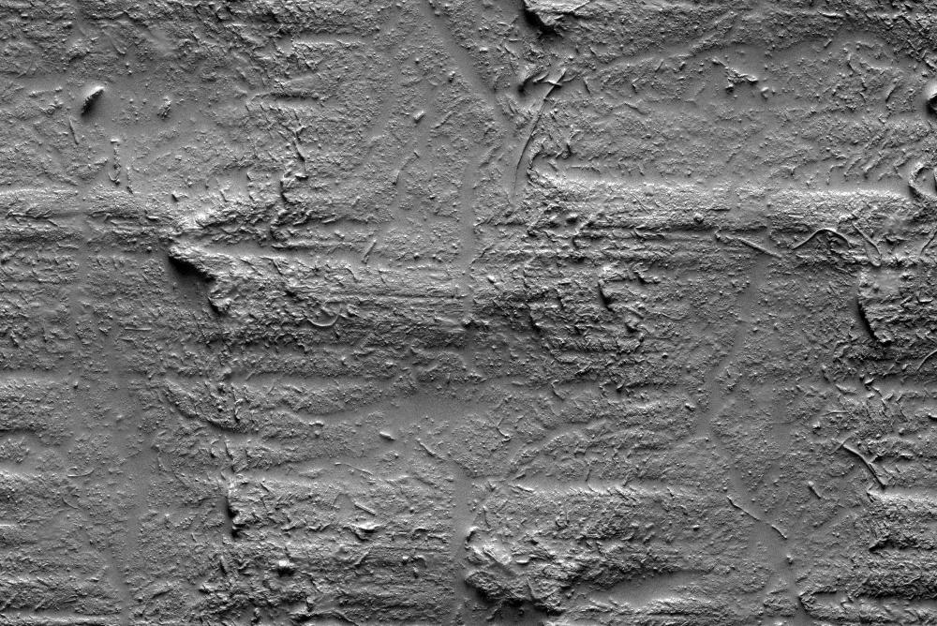
200

Slide 5
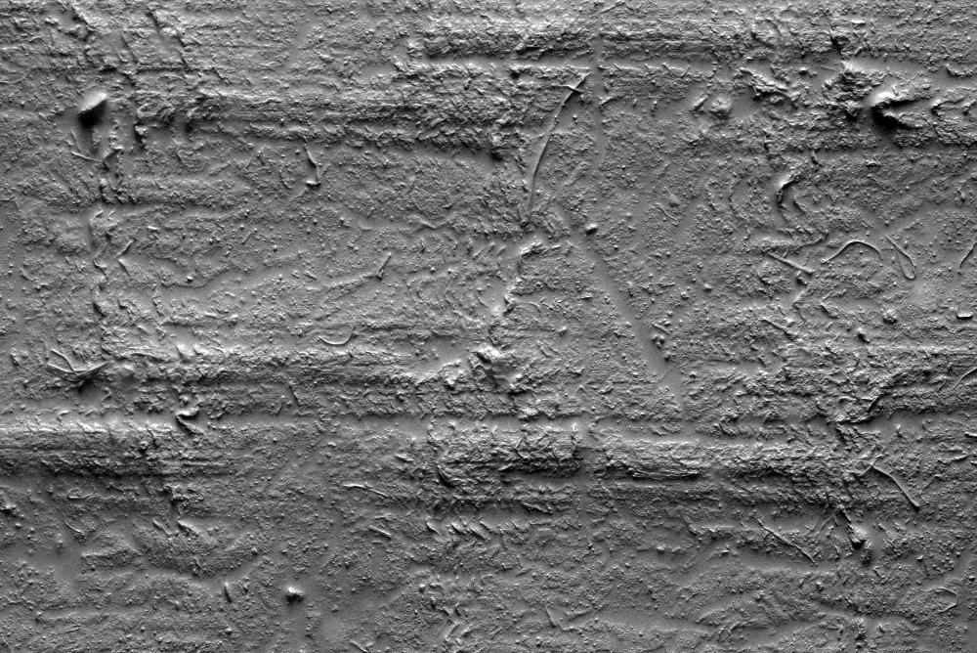
400

Slide 6

600

Slide 7
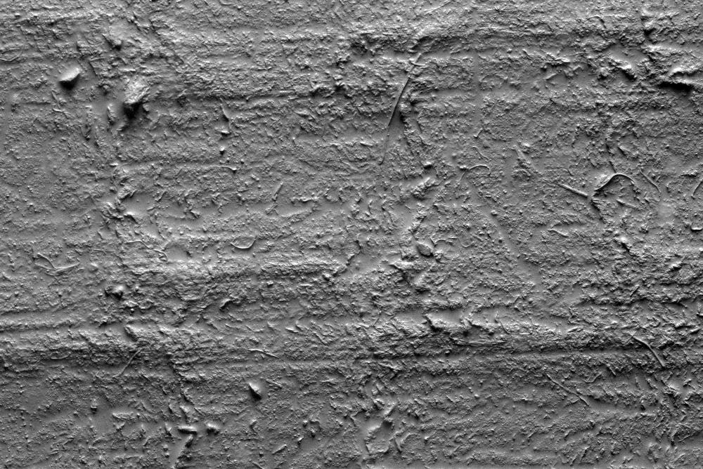
800

Slide 8
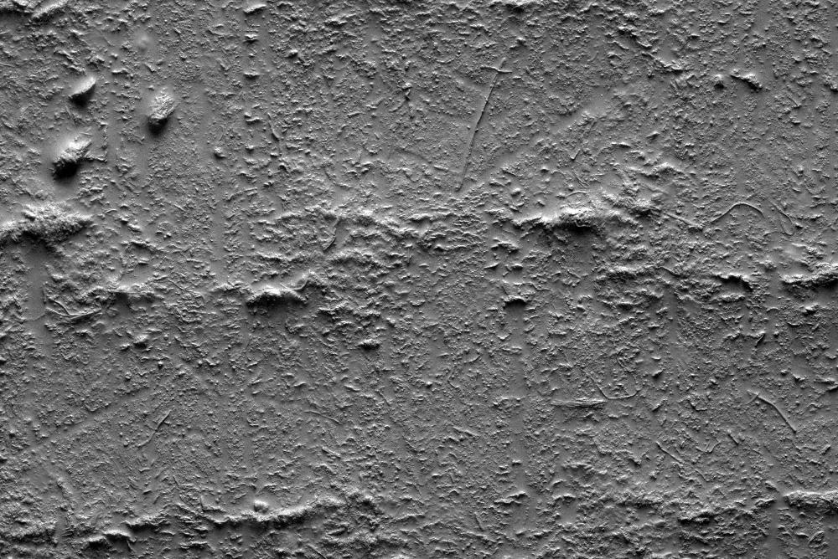
1000

